Slide 1
Deep Learning
Week 7

Slide 2
Objectives
Convolutional Neural Network (CNN) Architecture
Pooling
Flattening
Deep CNN Training
Transfer learning
Data Augmentation

Slide 3
Convolutional neural networks (CNN)
A convolution is a mathematical operation to merge two sets of information.
CNN is designed to learn spatial hierarchies of features through multiple building blocks, such as convolution layers, pooling layers, and fully connected layers.
Application
Object recognition
Text analysis
analyzing sound
Machine vision
…

Slide 4
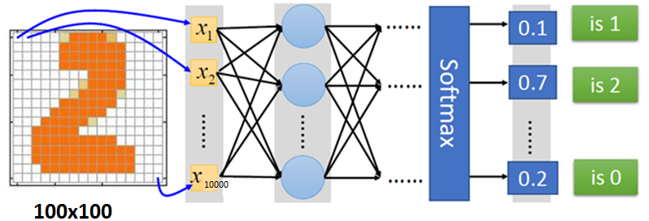
CNN vs deep neural networks (DNNs) challenge
A 100 × 100 image has 10,000 pixels, and if the first layer has just 1,000
➔ 10 million connections (just for the first layer).

Slide 5
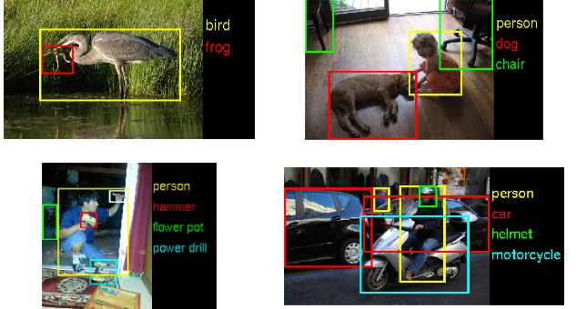
CNN solution
CNNs solve this problem using partially connected layers.
far fewer parameters than a fully connected DNN
reduces the risk of overfitting,
requires much less training data.
heavily reuses its weights,
much faster to train

Slide 6
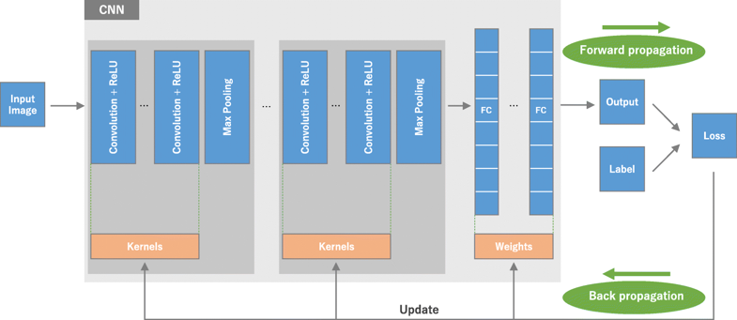
Convolutional neural network (CNN) in a nutshell
https://link.springer.com/article/10.1007/s13244-018-0639-9#Fig1

Slide 7
CNN Architecture
CNN is typically composed of following types of layers:
Input layer
Convolution
Pooling
Fully connected layers.
Convolution and pooling layers, perform feature extraction,
Fully connected layer, maps the extracted features into final output, such as classification.

Slide 8
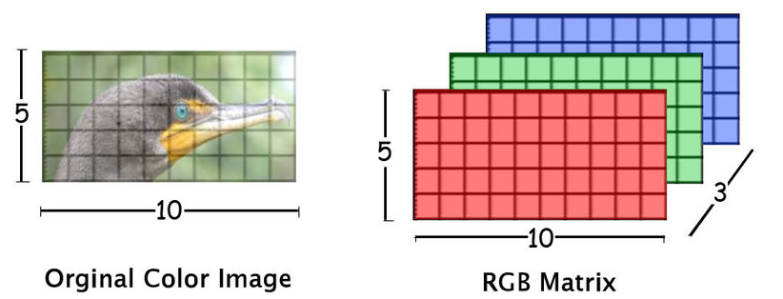
Input layers
Input layers are where we load the raw input data of the image.
This input data specifies the width, height, and number of channels.
Typically, the number of channels is three, for the RGB values for each pixel.

Slide 9

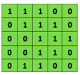
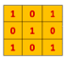
Convolution
Type of linear operation where a small array of numbers, called a kernel, is applied across the input (tensor).
Two key hyperparameters
are size (e.g. 3x3, 5x5 or 7x7) and number of kernels.
The number of kernels determines the depth of output feature maps.
Convolutional
3x3 filter
Input matrix

Slide 10
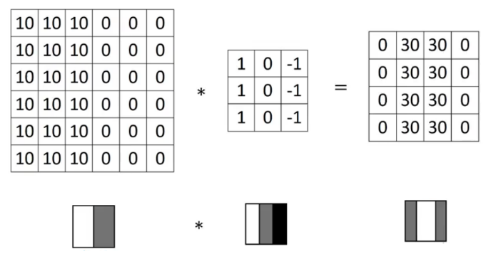
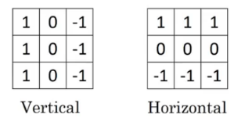
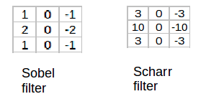
Convolution (cont.)
The output from each convolution layer is a set of objects called feature maps, generated by a single kernel filter.
The feature maps can be used to define a new input to the next layer.

Slide 11
1D Convolution
The convolution operation extracts different features of the input.
Convolution of an input with one kernel produces one output feature, and with H kernels independently produces H features

Slide 12
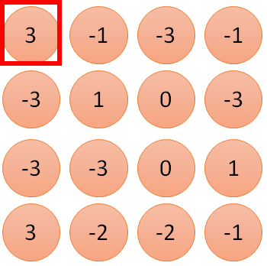
Convolution vs. fully connected
1
Hidden Node
1 | -1 | -1
-1 | 1 | -1
-1 | -1 | 1
0
0
0
1 | 0 | 0 | 0 | 0 | 1
0 | 1 | 0 | 0 | 1 | 0
0 | 0 | 1 | 1 | 0 | 0
1 | 0 | 0 | 0 | 1 | 0
0 | 1 | 0 | 0 | 1 | 0
0 | 0 | 1 | 0 | 1 | 0
.
.
.
0
1
0

Slide 13
Stride
Stride=1
1 | 0 | 0 | 0 | 0 | 1
0 | 1 | 0 | 0 | 1 | 0
0 | 0 | 1 | 1 | 0 | 0
1 | 0 | 0 | 0 | 1 | 0
0 | 1 | 0 | 0 | 1 | 0
0 | 0 | 1 | 0 | 1 | 0
The distance between two successive
kernel positions is called a stride.
Stride configures how far our sliding filter
window will move per application of the
filter function.
As the stride value goes up, the output
volume spatially goes down.
It’s been demonstrated that smaller
strides (e.g., 1) in convolutional layers
work better in practice.
A stride larger than 1 is sometimes
used in order to achieve down-sampling
of the feature maps.
Stride=2
1 | 0 | 0 | 0 | 0 | 1
0 | 1 | 0 | 0 | 1 | 0
0 | 0 | 1 | 1 | 0 | 0
1 | 0 | 0 | 0 | 1 | 0
0 | 1 | 0 | 0 | 1 | 0
0 | 0 | 1 | 0 | 1 | 0

Slide 14
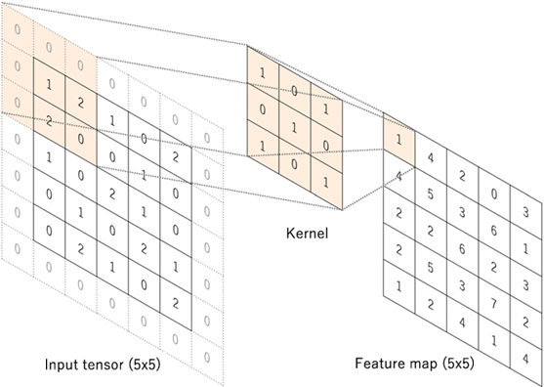
Zero padding
Zero padding to retain in-plane dimensions in order to apply more layers.
Zero-padding preserves input information along the borders.
Padding notation:
Valid: It means no padding.
If we are using valid padding,
the output will be smaller.
Same: Here, we apply padding
so that the output size is the
same as the input size.

Slide 15
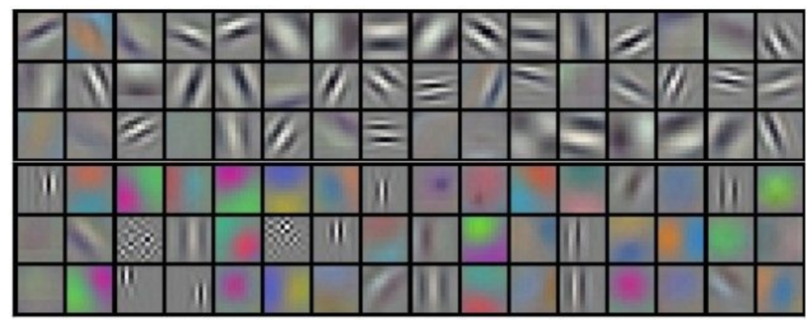
Choosing the number of filters
Each filter can look for something different in the input training data. As data variation and complexity rises, logically we’ll need more filters to capture the relevant features.

Slide 16
Configuring filter size
Smaller filters in multiple stacked convolutional layers tend to perform better as opposed to big filters in fewer convolutional layers.
As the filter size grows larger, the computational cost grows as well as we have to look at larger regions of the input per filter. Convolutions with larger spatial filters (e.g., 5 × 5 or 7 × 7) tend to be disproportionally expensive in terms of computation.
For example, a 5 × 5 convolution with n filters over a grid is 25/9 = 2.78 times more computationally expensive than a 3 x 3 convolution with the same number of filters.

Slide 17
Calculating spatial size of output volume
Output volume size = (W – F + 2P)/S + 1
Where
W ➔Input volume size
F ➔ Receptive field size of convolutional layer neurons
S ➔ Stride setting
P ➔ Zero-padding setting
If the result is not an integer, we might be able to fix it with padding, a different filter size, or by using the Truncate mode

Slide 18
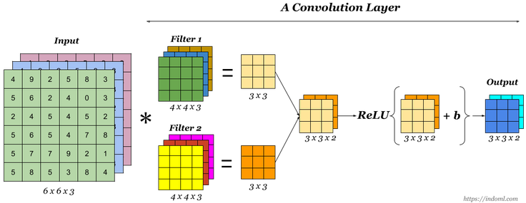
Non-linear layers
Convolutional Neural Network (CNN) Architecture
Neural networks in general and CNNs in particular rely on a non-linear “trigger” function to signal distinct identification of likely features on each hidden layer.

Slide 19
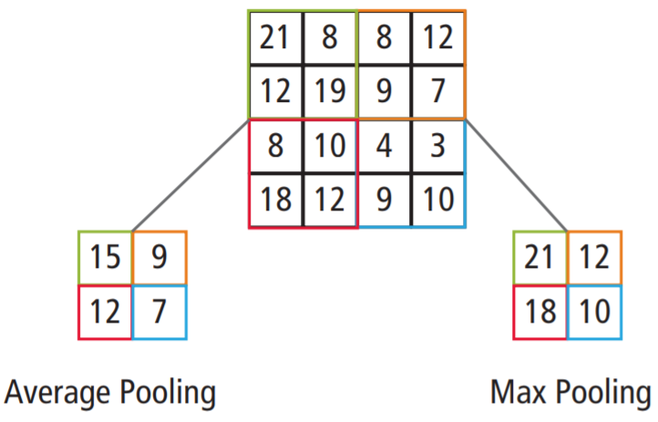
Pooling layer
The pooling (subsampling) layer reduces the resolution of the features.
It makes the features robust against noise and distortion.
There are two ways to do pooling:
Max pooling
Average pooling.
Sum pooling

Slide 20
Pooling layer (cnt.)
Commonly inserted between successive convolutional layers
Help to:
progressively reduce the spatial size of the data representation.
control overfitting.
Operates independently on every depth slice of the input.
Max or average are some of the down-sampling operations
The most common setup for a pooling layer is to apply 2 × 2 filters with a stride of 2.

Slide 21
Fully connected layer
The output feature maps of the final convolution or pooling layer is typically flattened, i.e., transformed into a one-dimensional (1D) array of numbers (or vector), and connected to one or more fully connected layers, also known as dense layers, in which every input is connected to every output by a learnable weight.
We use this layer to compute class scores that we’ll use as output of the network (e.g., the output layer at the end of the network).
The dimensions of the output volume is [ 1 × 1 × N ], where N is the number of output classes we’re evaluating

Slide 22
CNN Hyper-Parameters
Layer | Parameters | Hyperparameters
Convolution layer | Kernels | Kernel size, number of kernels, stride, padding, activation function
Pooling layer | None | Pooling method, filter size, stride, padding
Fully connected layer | Weights | Number of weights, activation function
Others |  | Model architecture, optimizer, learning rate, loss function, mini-batch size, epochs, regularization, weight initialization, dataset splitting

Slide 23
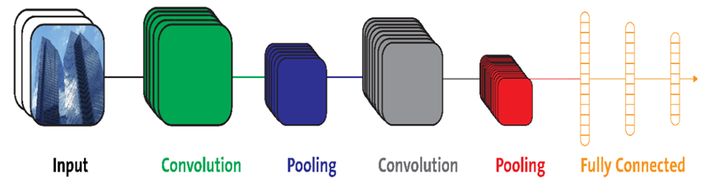
Configuration of CNN layers
Set up the spatial arrangement of the convolutional layer and then choose the number of filters
How we set up the hyperparameters in a convolutional layer dictates how many neurons there are in the output volume and how they are arranged.

Slide 24
Example of CNN
LeNet
By Yann Lecun, Originally used to read digits in images
AlexNet
By Alex Krizhevsky et al., for computer vision (ILSVRC 2012)
ZF Net
By Matthew Zeiler et al. Deconvolutional Network (ILSVRC 2013)
GoogLeNet
By Christian Szegedy et al. (ILSVRC 2014)
VGGNet
By Karen Simonyan et al. Showed that depth of network was a critical factor in good performance
ResNet
Trained on very deep networks (up to 1,200 layers), Won first in the ILSVRC 2015 classification task

Slide 25
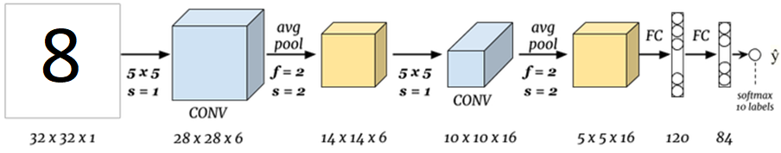
LeNet
Number of parameters: ~ 60 thousands

Slide 26
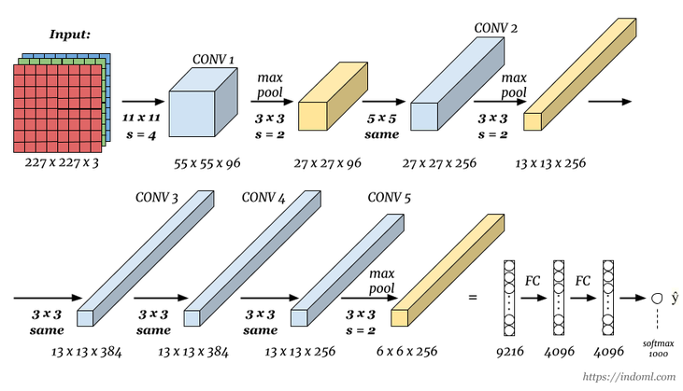
AlexNet
Number of parameters: ~ 60 millions

Slide 27

VGG-16
Number of parameters: ~ 138 millions.

Slide 28
Image augmentation
To make the model more size-invariant, we can add different sizes of the image to the training set.
To make the model more rotation-invariant, we can add images with different angles.
This also helps to avoid overfitting. Overfitting happens when a model is exposed to very few samples.
Mirroring
Random cropping
Color shifting

Slide 29
Image augmentation
Here is the index of techniques we will be using in data augmentation:
Scaling
Translating
Rotation
Flipping
Adding salt and pepper noise
Lightening condition
Perspective Transform

Slide 30
Image augmentation
Translation

Slide 31
Image augmentation
Adding salt and pepper Noise

Slide 32
Image augmentation
Perspective Transformation

